Slide 1
UML Sequence Diagram

Slide 2
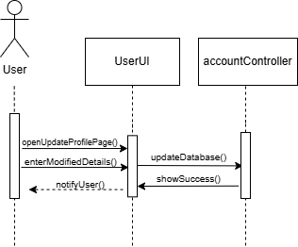
Title: 01.02.Modify Account
Steps:
User opens Profile
User opens the modify details page
User modifies information
Database is updated with the modified data
System shows success
Notify user modification successful

Slide 3
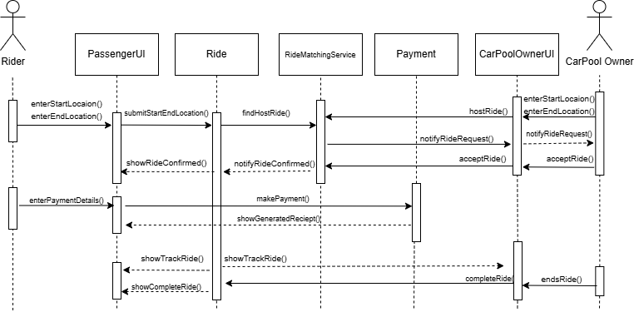
Title: 02.01.Search Vehicle, 02.04.Book Vehicle, 03.01.Process Payment
Steps:
Carpool Owner enters start location and the end location and hosts the ride
Ride enter the start location and the end location and finds for the hosted rides.
Owner get the notification to start ride.
Owner starts ride
Rider enters the payment details
Payment is processed
Carpool owner ends the ride
Rider is notified that ride is completed

Slide 4
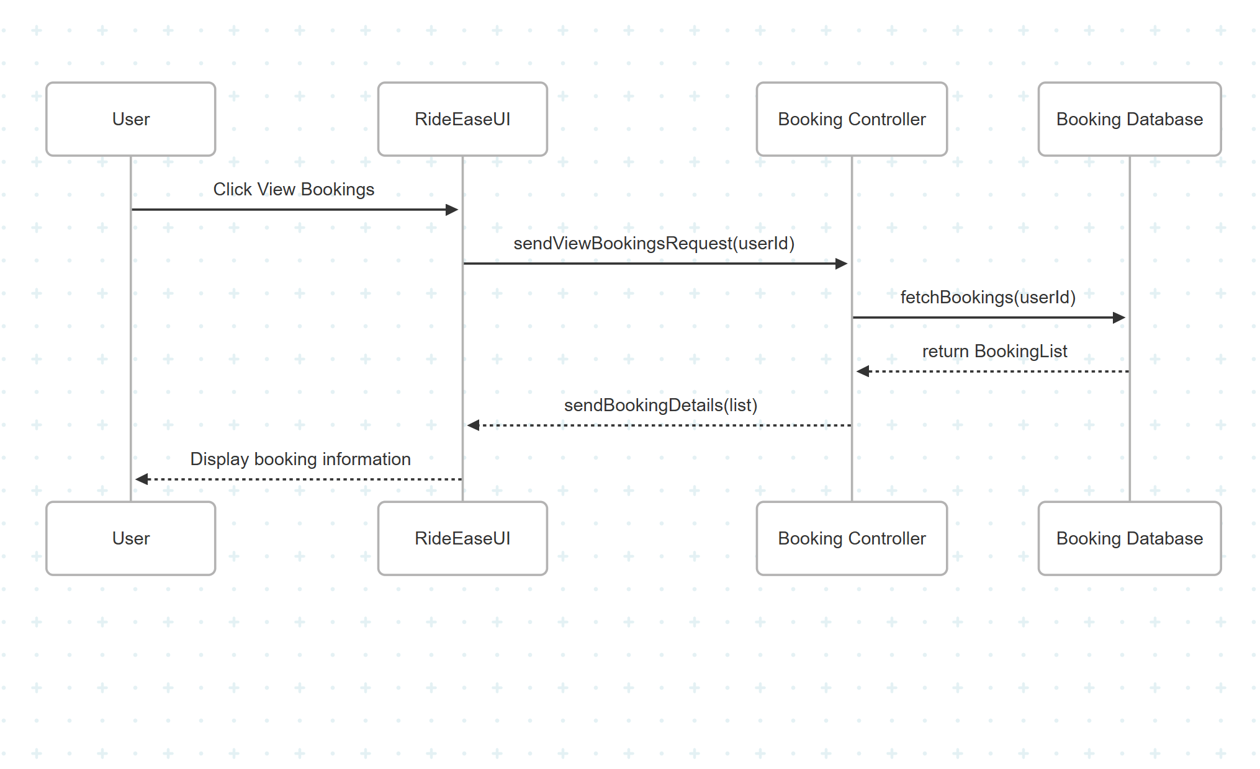
Title: 04.01. View Booking
Steps
Rider opens the "My Bookings".
The UI sends a request to BookingController to fetch user's bookings.
BookingController calls BookingService to get the booking list.
BookingService queries the BookingRepository (or database).
The repository returns the list of bookings.
The service sends the booking list to the controller.
The controller returns the booking data to the UI.
The UI displays the ride history with status, date, and fare.

Slide 5
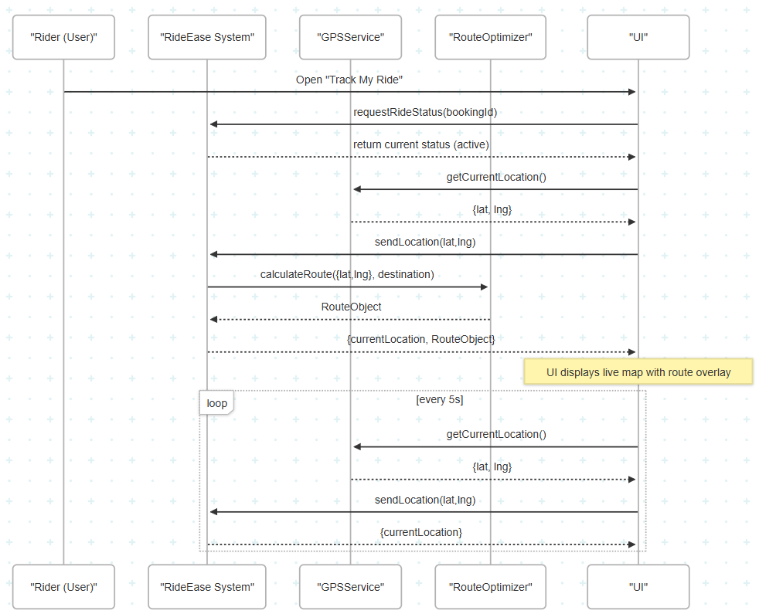
Title: 04.02. GPS Tracking
Steps
The rider opens the “Track My Ride” after booking ride.
The system requests the ride status using the rider’s booking ID.
The system verifies that the ride is active.
The system requests the rider’s current GPS location.
The GPS service returns current {lat, lng}.
Location is sent to the RouteOptimizer module.
RouteOptimizer calculates the optimized route from current location to destination.
The optimized route is sent back to the system.
The UI receives both current location and route overlay and displays it on the map.
A loop runs every 5 seconds to update the rider’s real-time location using the same logic.

Slide 6
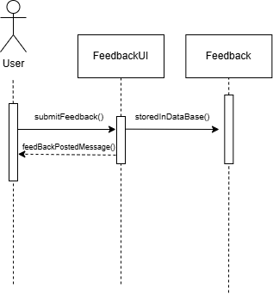
Title: 05.01.Collect feedback
User Story:
User writes the feedback.
User submits the feedback.
Feedback is stored to the database

